Slide 1

WM275: Machine Intelligence
Day 2: Search

Slide 2
Recap
Introduction to Machine intelligence
Intelligent Agents
Search:
Uninformed Search, Uninformed Search
Informed search and exploration
Adversarial Search
Constraint satisfaction problems
Knowledge and reasoning:
Logic, propositional logic, Inference using logic, Intro to first order logic

Slide 3
Recap
Introduction to Machine intelligence
Agents and environments
Rationality
PEAS (Performance measure, Environment, Actuators, Sensors)
Environment types
Agent types

Slide 4
Outline
Search
Uninformed Search
Breadth first search
Depth first search
Iterative deepening search
Uniform cost search
Bidirectional search

Slide 5
What is Search?
It is the process of looking for a sequence of actions that reaches the goal
Reflex or goal based?
What kind of agent is best suited for this task?

Slide 6
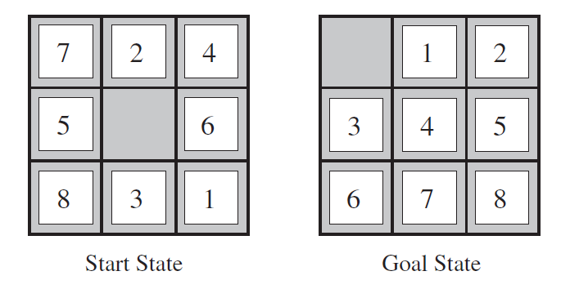
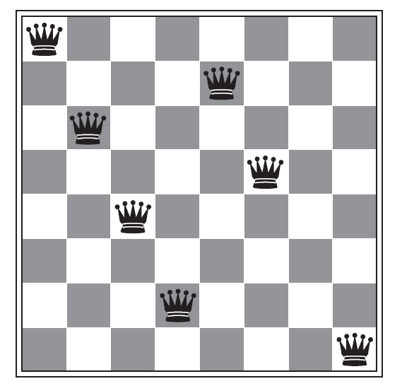
Examples of search problems
8 Puzzle
N-queens
Can you think of some practical problems that can be posed as a search problem?
Notes:
VLSI layout, TSP, Assembly sequencing, robot navigation etc.

Slide 7
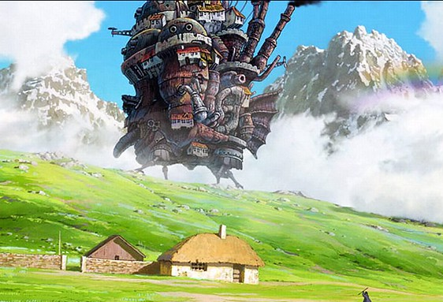
Scope of search problems
In this module, limited to problems for which the solution is always a fixed sequence of actions
So, what type of task environment will satisfy our scope?
Castle image credit: https://www.flickr.com/photos/digerati/51340107

Slide 8
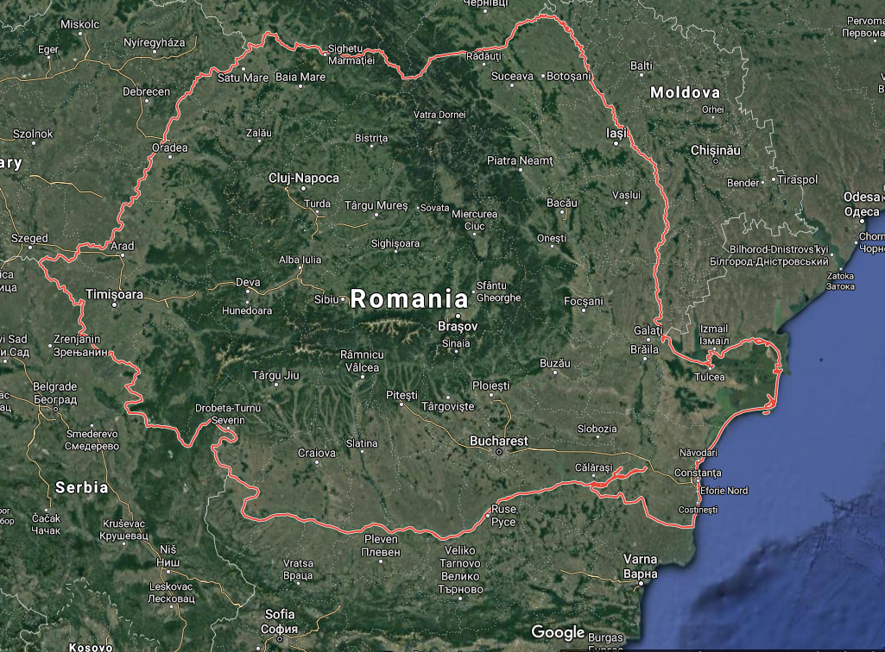
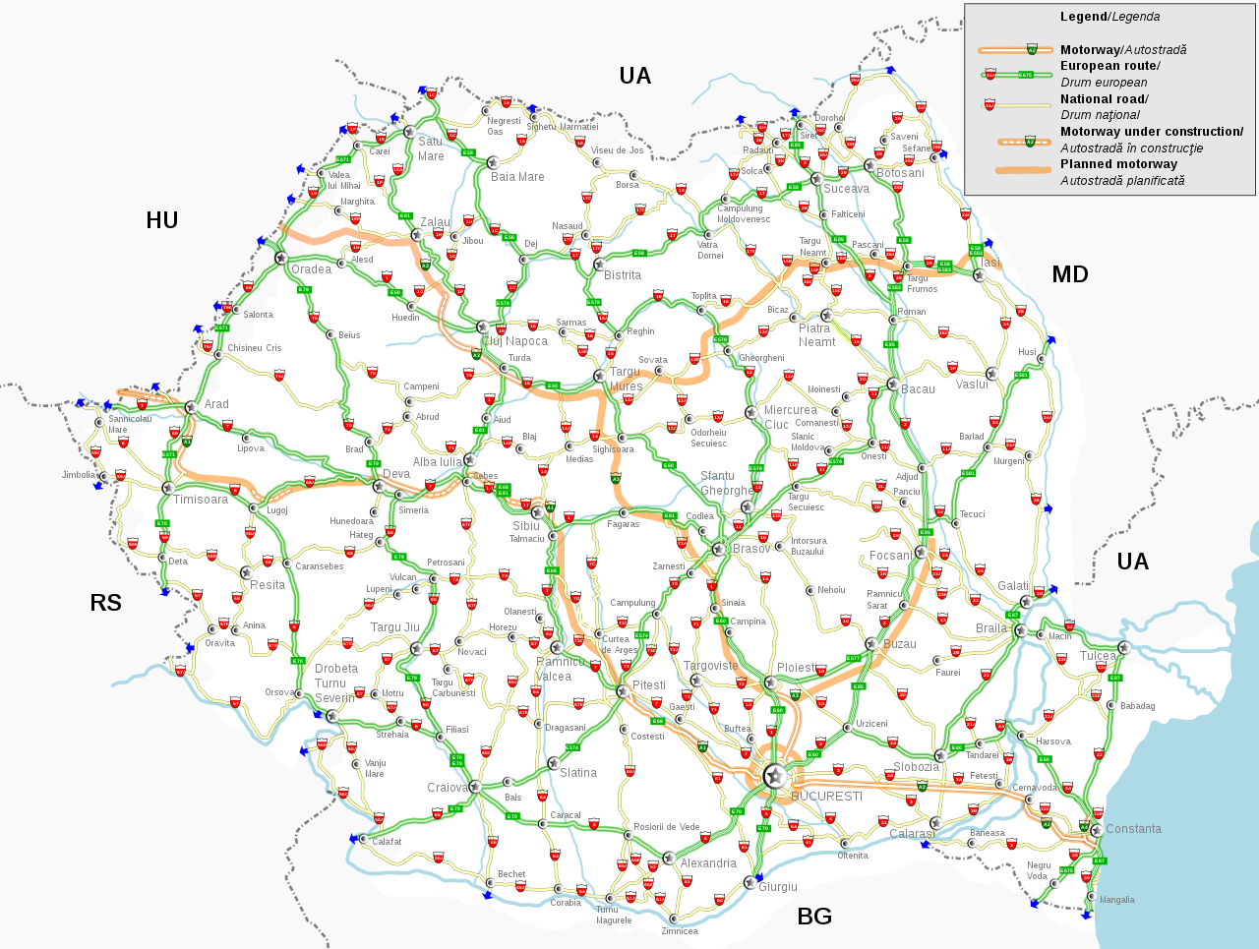
Problem formulation
Is the process of deciding what states and actions to consider, given a goal.
Notes:
This process almost always begins with building a model, i.e., a (mathematical) abstraction of the real world.
State is any information/description of the world that is relevant to solve the problem.
Action are possible legal options that an agent can choose to execute

Slide 9
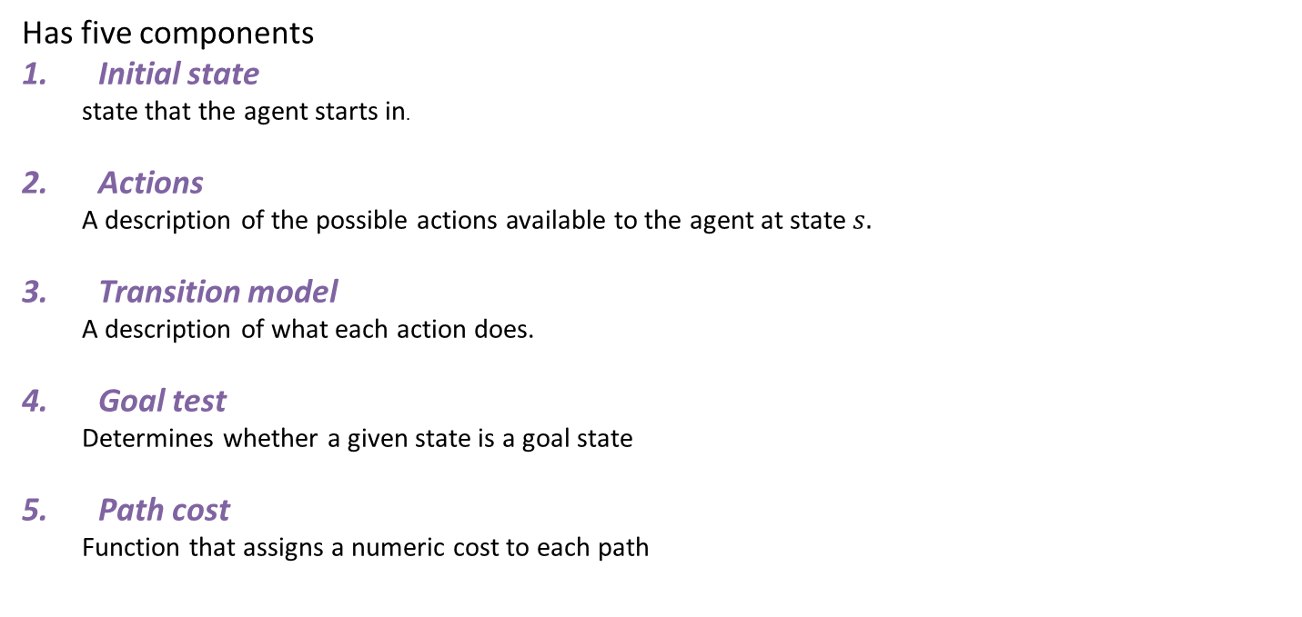
Well defined problem
Has five components
Initial state
state that the agent starts in.
Actions
A description of the possible actions available to the agent at state $s.$
Transition model
A description of what each action does.
Goal test
Determines whether a given state is a goal state
Path cost
Function that assigns a numeric cost to each path
Notes:
In step 3 talk about state space, graph (node – state, edge – action), path – sequence of states connected by actions

Slide 10

Problem formulation: Romanian travel
State: City
State space?
Initial state:
Arad
Actions:
Go to adjacent city
Transition model:
Reach adjacent city
Goal test:
Are we in Bucharest? Or is current state Bucharest?
Action cost:
Road distance from city 1 to city 2
Solution?

Slide 11
State space graph: Romanian travel

Slide 12
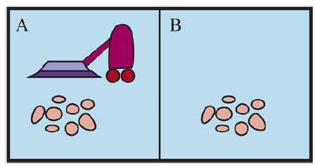
Problem formulation: Vacuum world
States:
Initial state:
Actions:
Transition model:
Goal test:
Action cost:

Slide 13
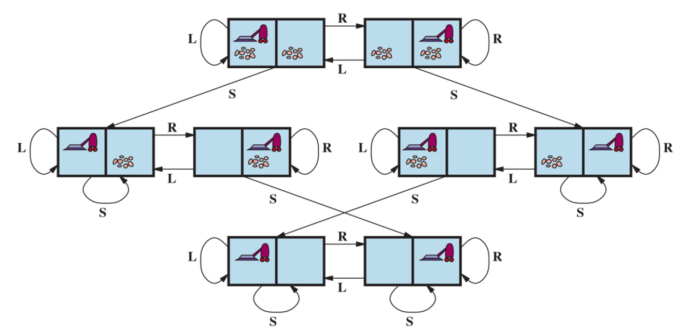
State space graph: Vacuum world
Notes:
S= clean/vacuum

Slide 14
Searching for a solution

Slide 15
Searching for a solution
Remember?
Solution is a sequence of actions that reaches the goal.
So, starting from the initial state we start exploring possible actions.
This gives rise to a search tree

Slide 16
Search tree: Romanian travel
Root node

Slide 17
Search tree: Romanian travel
Leaf node
Frontier
Notes:
leaf node, a node with no children in the tree
The set of all leaf nodes available for expansion at any given point is called the frontier

Slide 18
Search tree: Romanian travel
Did you notice something odd?
Notes:
Even though the state space is finite the search tree can be infinite

Slide 19
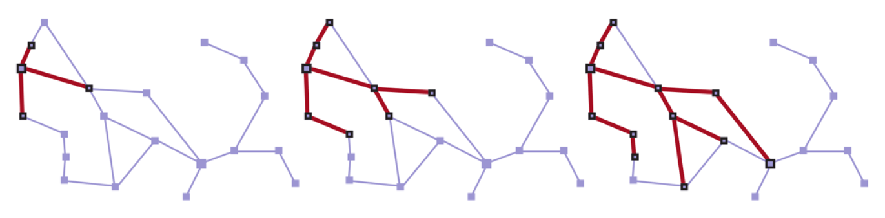
Graph search
Has additional book keeping in the form of explored set
Search trees generated by a graph search on the Romania problem

Slide 20
Graph search
In Graph search the frontier separates the state-space graph into the explored region and the unexplored region
Every path from the initial state to an unexplored state has to pass through a state in the frontier.

Slide 21
Uninformed/blind search

Slide 22
Uninformed/blind search
These search strategies have no additional information about states beyond that provided in the problem definition.
Can distinguish a goal state from a non-goal state
All search strategies are distinguished by the order in which nodes are expanded

Slide 23
An illustrative search problem
a
G
b
c
e
d
f
S
h
p
r
q
Tiny state space graph for a tiny search problem
Source [2]

Slide 24
Measure of performance

Slide 25
Measuring problem-solving performance
Completeness: Is the algorithm guaranteed to find a solution when there is one?
Optimality: Does the strategy find the optimal solution, in terms of lowest path cost.
Time complexity: How long does it take to find a solution? Typically measured in terms of number of nodes expanded before finding a solution.
Space complexity: How much memory is needed to perform the search? Typically measured in terms of maximum number of nodes stored in memory before finding a solution.

Slide 26
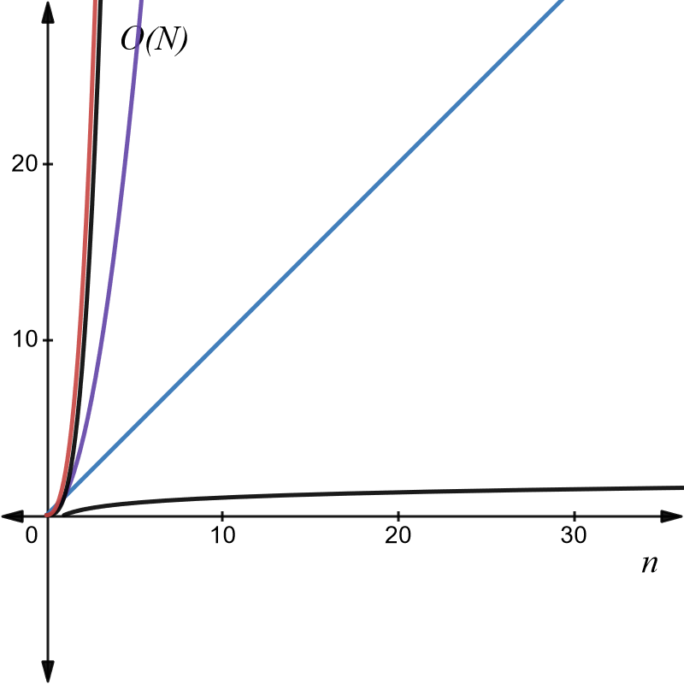

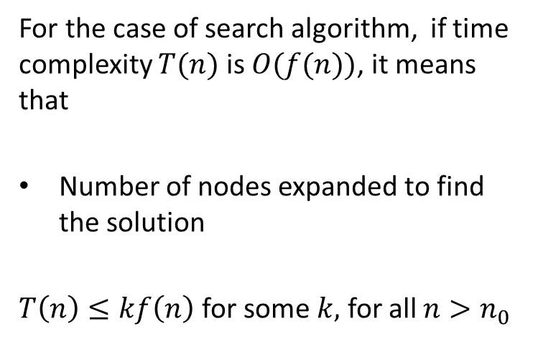
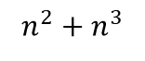
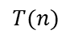

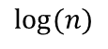
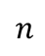
Big O notation
For the case of search algorithm, if time complexity $T(n)$ is $O(f(n))$, it means that
Number of nodes expanded to find the solution
$T\left(n\right)≤kf\left(n\right)$for some $k,$ for all $n>n_{0}$
$$n^{3}$$
$n$
$${n^{2}+n}^{3}$$
$$n^{2}$$
$T(n)$
$log⁡(n)$
Interactive version here: https://www.desmos.com/calculator/bb7nukcap5
Notes:
This is necessary as it is quite difficult to exactly calculate the runtime of any algorithm.
So we tend to take the limit n→inf
Typically there is also the worst case and the average case.

Slide 27
Breadth-First Search

Slide 28
Breadth-First Search
a
G
b
c
Strategy: Expand a shallowest node first
Implementation: Frontier is a FIFO queue
d
e
f
S
h
p
q
r
S
d
e
p
Search
Tiers
b
c
e
h
r
q
a
a
h
r
p
q
f
p
q
f
q
c
G
q
c
G
a
a
Source [2]

Slide 29
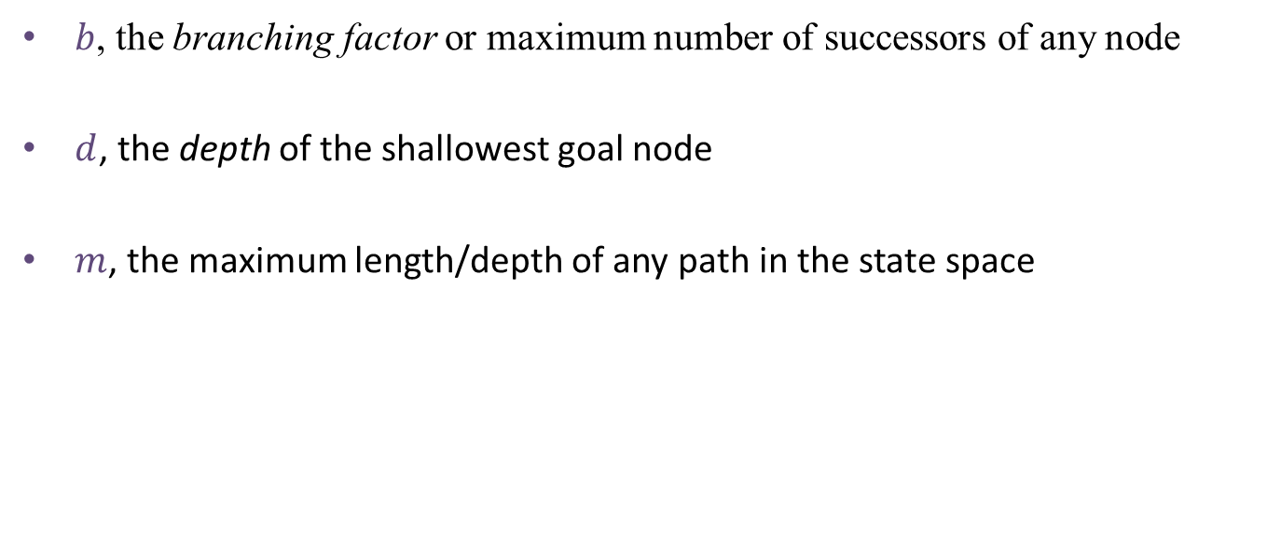
Necessary terminologies
$b$, the branching factor or maximum number of successors of any node
$d$, the depth of the shallowest goal node
$m$, the maximum length/depth of any path in the state space

Slide 30
Breadth-First Search (BFS) Properties
What nodes does BFS expand?
Processes all nodes above shallowest solution
Let depth of shallowest solution be d
Number of nodes expanded = 1+b+b²…+b^{d}
Search takes time O(b^{d})
How much space does the frontier take?
Has roughly the last tier, so O(b^{d})
Is it complete?
d must be finite if a solution exists, so yes!
Is it optimal?
If costs are equal (e.g., 1)
1 node
b
…
b nodes
d tiers
b² nodes
b^{d} nodes
b^{m} nodes
How good do you think the performance of BFS is?
Illustration Source [2]

Slide 31
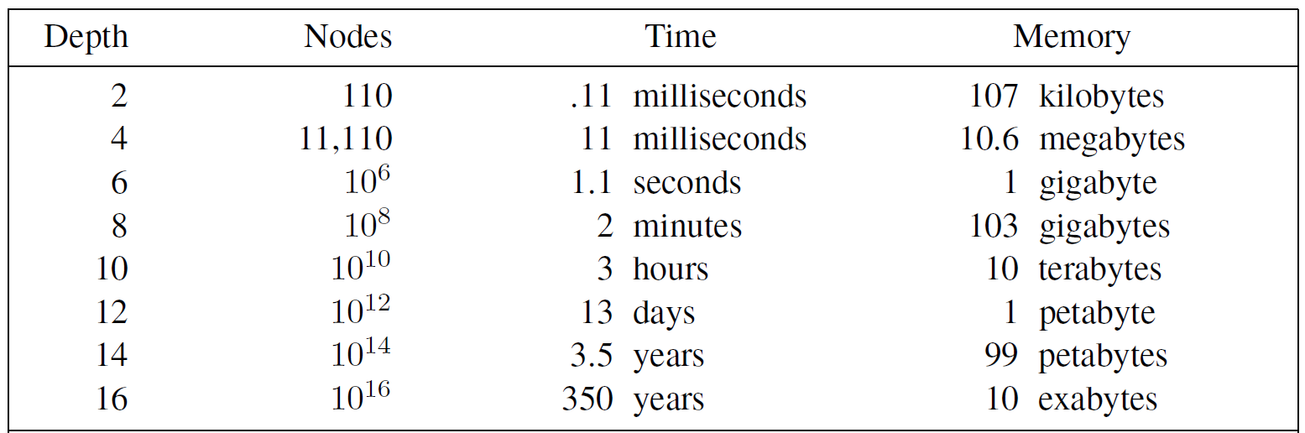
Time and memory requirements for breadth-first search.
The numbers shown assume branching factor b = 10;
1 million nodes/second; 1000 bytes/node
Notes:
First, the memory requirements are a bigger problem for breadth-first search than is the execution time.
The second lesson is that time is still a major factor.

Slide 32
Depth-First Search

Slide 33
Depth-First Search
a
G
a
c
Strategy: expand a deepest node first
Implementation: Frontier is a LIFO stack
b
c
b
e
d
e
d
f
f
S
h
h
p
p
r
q
r
q
S
d
e
p
b
c
e
h
r
q
a
a
h
r
p
q
f
p
q
f
q
c
G
q
c
G
a
a
Illustration Source [2]

Slide 34
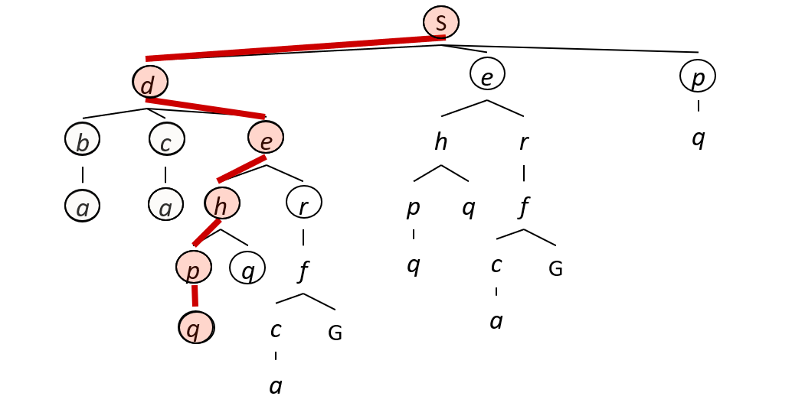
Depth-First Search (DFS) Properties
What nodes does DFS expand?
Some left prefix of the tree down to depth m.
Could process the whole tree!
If m is finite, takes time O(b^{m})
How much space does the frontier take?
Only has siblings on path to root, so O(bm)
Is it complete?
m could be infinite
preventing cycles may help
Is it optimal?
No, it finds the “leftmost” solution, regardless of depth or cost
1 node
b
…
b nodes
b² nodes
m tiers
b^{m} nodes
Illustration Source [2]
Notes:
The graph search version of DFS has no space advantage as all visited states mut be stored and thus will become similar to BFS.
Tree search DFS is prone to get stuck on loops, but algorithm can be modified to check (at const cost) if a state has been visited before in the current path from root.

Slide 35
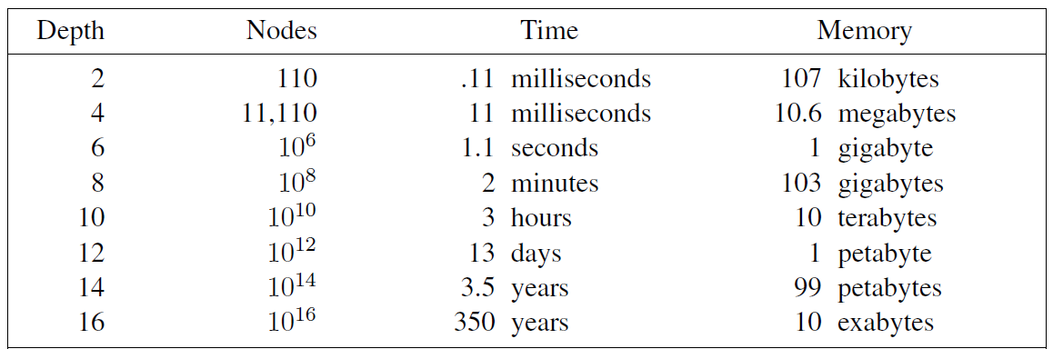
Time and memory requirements for depth-first search.
For breadth-first search.
156 Kilobytes
The numbers shown assume branching factor b = 10;
1 million nodes/second; 1000 bytes/node
Notes:
time is still a major factor.

Slide 36
Question?
When is DFS better than BFS?
When is BFS better than DFS?

Slide 37
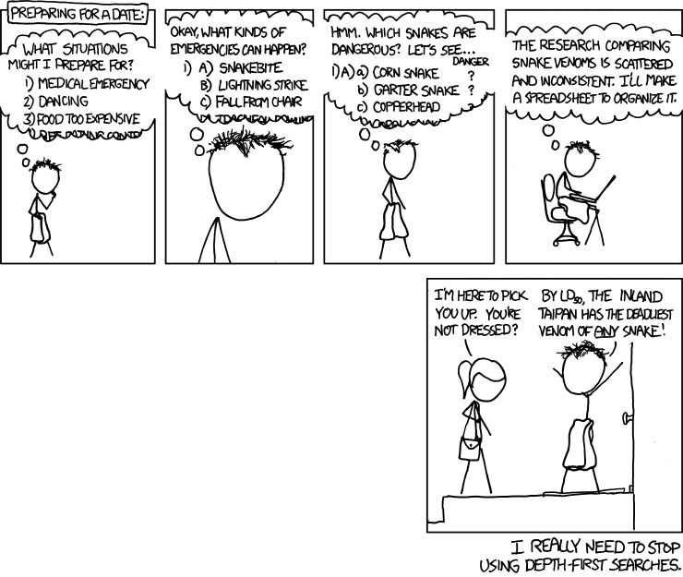
Questions?
https://xkcd.com/761/

Slide 38
Iterative Deepening Search (IDS)
Idea: get DFS’s space advantage with BFS’s time / shallow-solution advantages
Run a DFS with depth limit 1. If no solution…
Run a DFS with depth limit 2. If no solution…
Run a DFS with depth limit 3. …..
Isn’t that wastefully redundant?
Generally most work happens in the lowest level searched, so not so bad!
b
…
Source [2]
Notes:
1 + (1+b) + (1+b+b²) + … + (1+b+…+b^{s}) = (s+1) + sb + (s-1)b² + … + b^{s} = O(b^{s})

Slide 39
Uniform Cost Search
2
G
a
g(n) = cost from root to n
Strategy: expand lowest g(n)
Frontier is a priority queue sorted by g(n)
c
b
1
8
2
2
3
d
e
f
9
8
2
S
h
1
1
p
q
r
15
0
S
d
3
e
9
p
1
b
4
e
5
h
17
r
11
q
16
c
11
Cost contours
a
6
a
h
13
r
7
p
q
f
p
q
f
8
q
c
G
q
c
a
11
G
10
a
Source [2]
Notes:
Goal test is applied only after a node is selected for expansion rather than when it was generated,

Slide 40
Uniform Cost Search (UCS) Properties
What nodes does UCS expand?
Processes all nodes with cost less than cheapest solution!
If that solution costs C* and arcs cost at least ε , then the “effective depth” is roughly C*/ε
Takes time O(b^{C*/ε}) (exponential in effective depth)
How much space does the frontier take?
Has roughly the last tier, so O(b^{C*/ε})
Is it complete?
Assuming C* is finite and ε > 0, yes!
Is it optimal?
Yes! (Proof next lecture via A*)
b
g ≤ 1
…
C*/ε “tiers”
g ≤ 2
g ≤ 3
Source [2]

Slide 41

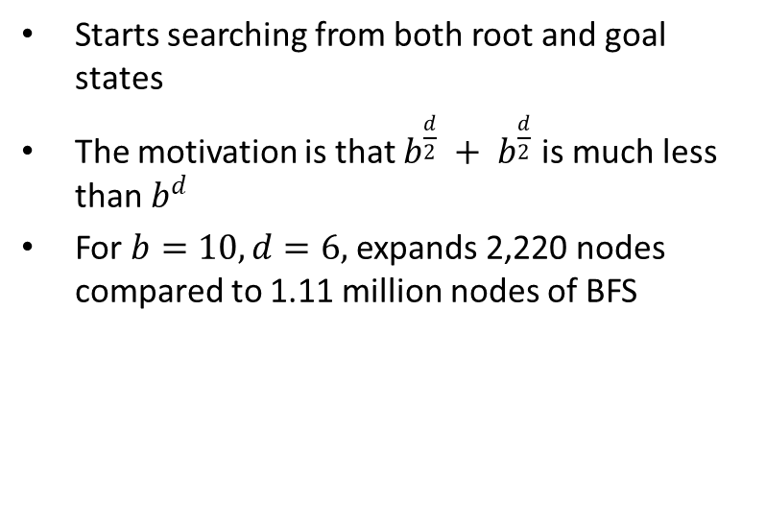
Bidirectional Search (BDS)
Starts searching from both root and goal states
The motivation is that $b^{\frac{d}{2}} + b^{\frac{d}{2}}$ is much less than $b^{d}$
For $b=10, d=6,$expands 2,220 nodes compared to 1.11 million nodes of BFS
Source: http://qiao.github.io/PathFinding.js/visual/
Notes:
Space complexity is still high at b^(d/2) .
State space must be reversible.

Slide 42
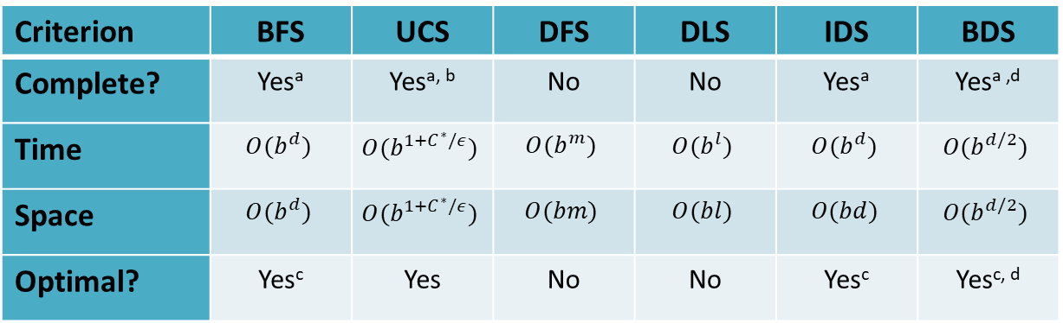
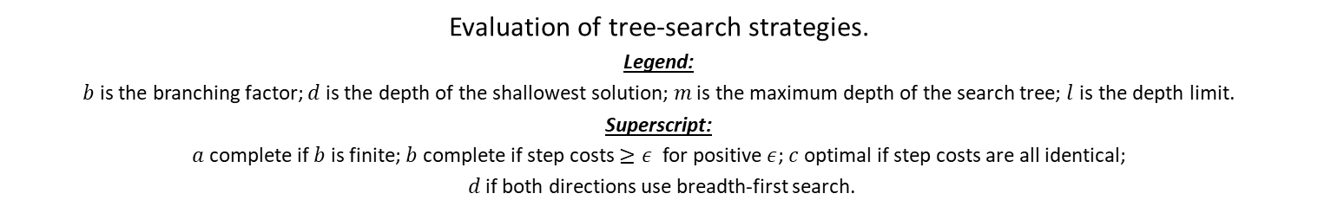
Comparison of various search
Criterion | BFS | UCS | DFS | DLS | IDS | BDS
Complete? | Yesª | Yes^{a, b} | No | No | Yesª | Yes^{a ,d}
Time | $$O(b^{d})$$ | $$O(b^{1+C^{∗}/ε})$$ | $$O(b^{m})$$ | $$O(b^{l})$$ | $$O(b^{d})$$ | $$O(b^{d/2})$$
Space | $$O(b^{d})$$ | $$O(b^{1+C^{∗}/ε})$$ | $$O(bm)$$ | $$O(bl)$$ | $$O(bd)$$ | $$O(b^{d/2})$$
Optimal? | Yes^{c} | Yes | No | No | Yes^{c} | Yes^{c, d}
Evaluation of tree-search strategies.
Legend:
$b$is the branching factor; $d$ is the depth of the shallowest solution; $m$ is the maximum depth of the search tree; $l$ is the depth limit.
Superscript:
$a$ complete if $b$ is finite; $b$ complete if step costs $≥ε$ for positive $ε$; $c$ optimal if step costs are all identical;
$d$ if both directions use breadth-first search.

Slide 43
Recap
Introduction to Machine intelligence
Intelligent Agents
Search:
Uninformed Search, Uninformed Search
Informed search and exploration
Adversarial Search
Constraint satisfaction problems
Knowledge and reasoning:
Logic, propositional logic, Inference using logic, Intro to first order logic

Slide 44
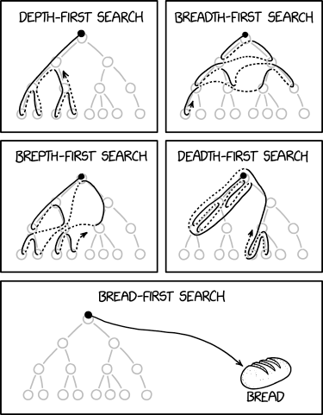
Questions?
https://xkcd.com/2407

Slide 45
Bibliography and References
Artificial Intelligence: Pearson New International Edition: A Modern Approach, Pearson Education UK, 2013.
CS188, Introduction to Artificial Intelligence. https://inst.eecs.berkeley.edu/~cs188
Tatsunori Hashimoto, Jiajun Wu, CS221: Artificial Intelligence: Principles and Technique. https://stanford-cs221.github.io/winter2021/
Chris Piech, Artificial Intelligence: Principles and Techniques. https://stanford.edu/~cpiech/cs221/index.html
Amy Greenwald, Enrique Areyan, CSC1410: Artificial Intelligence. http://cs.brown.edu/courses/cs141/
Poole, David L., and Alan K. Mackworth. Artificial Intelligence: foundations of computational agents. 2nd Edition. Cambridge University Press, 2017.

